Slide 1





Detect email spam usïng multïple classification algorïthms

Slide 2

Email has become oneofthemostwidely usedDrms of communicationintoday's digitaIworId.Howeverthe increasing numberofspammessages—suchas unwanted advertisements,phishingemaiIs,and fraudulentcontent—has created seriouschallengesDr users
Manual filtering of spam emails is time-consuming and inefficient. To overcome this issue, machine learning techniques can be used to automatically detect and classify emails as spam or not spam.
This project focuses on developing an Email Spam Detection system using multiple classification algorithms such as Logistic Regression, Support Vector Machine (SVM), and K-Nearest Neighbors (KNN). The system processes and analyzes email text, converts it into numerical form using TF-IDF, and applies these algorithms fo accurately classify messages.

Slide 3






iem
eme
Email spam detection in ML
In todag's digital world, email communication is widely used, but it is also heavily affected bg spam messages, which can be annoying, misleading, or even harmful.
Manually filtering spam emails is time-consuming and
inefficient.
The objective of this project is to develop a machine learning-based system that can automatically classify emails as spam or not spam (ham) using text analysis techniques. The system will utilize multiple classification algorithms such as Logistic Regression, Support Vector Machine (SVM), and K-Nearest Neighbors (KNN) to analyze and compare their performance.
The project involves preprocessing textual data, converting it into numerical form using techniques like TF-IDF, training different models, and evaluating them based on performance metrics such as accuracy, precision, recall, and F1-score.
The goal is to identify the most efficient algorithm for spam detection and build a reliable model that can be used for real-world email filtering.

Slide 4









This project aims to build a machine learning system to classify emails as spam or not spam (ham).
It helps in automatically filtering unwanted messages, improving user experience and security.
The dataset used contains labeled messages (spam and ham).
Data preprocessing is performed to clean the text:
Convert text to lowercase
Remove special characters
Remove stopwords
The cleaned text is converted into numerical form using TF-IDF, which highlights important words.
Three algorithms are used:
Logistic Regression (simple and fast)
Support Vector Machine (SVM) (high accuracy)
12. K-Nearest Neighbors (KNN) (based on similarity)
13.The dataset is split into training and testing data to evaluate performance.
Models are evaluated using: Accuracy Precision
Recall
F1-score
Among all models, SVM gives the best performance.
The final system can predict whether a new message is spam or not.

Slide 5
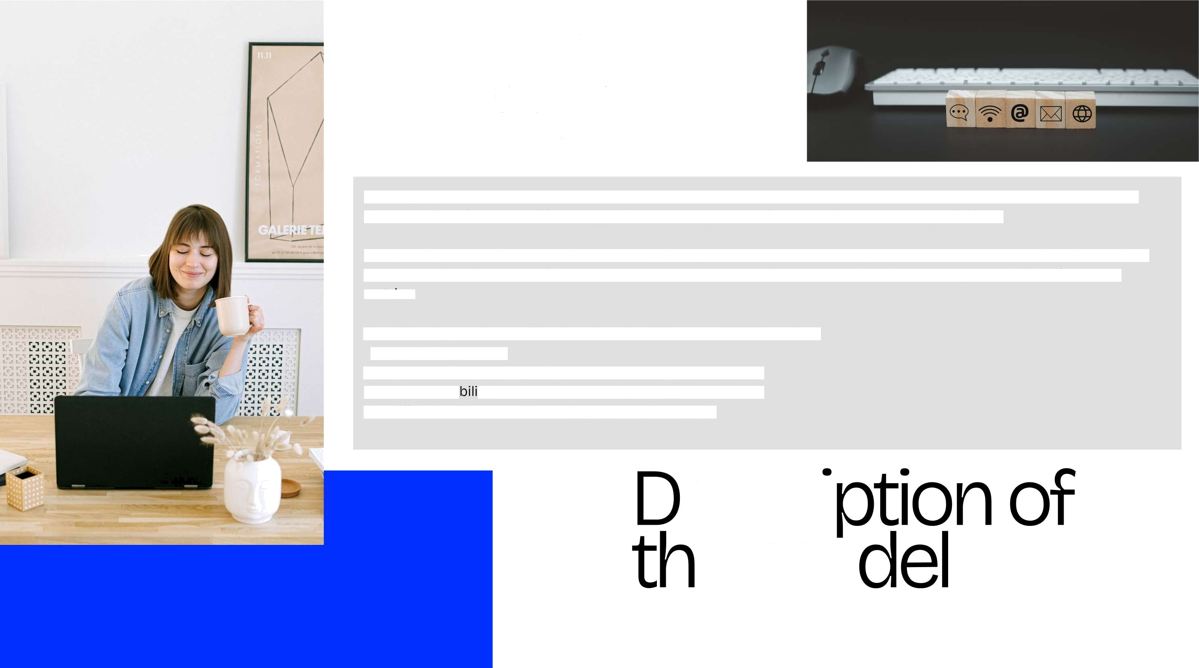
Key Points:
Simple and fast
Works weft for linearly separable data Easy to interpret
In this project, multiple machine learning classification algorithms are used to identify whether an email is spam or not. Each algorithm follows a different approach to learn patterns from the data and make predictions.
Using multiple algorithms helps in comparing their performance and selecting the most accurate and efficient model for spam detection. These algorithms are trained on preprocessed text data and evaluated using standard performance metrics.
The following are the machine learning algorithms used in this project:
1. Logistic Regression
A supervised learning algorithm used for binary classification Predicts proba ty between 0 and 1 using a sigmoid function
Classifies data into two classes (e.g., spam / not spam)
escri
e mo

Slide 6


2. Support Vector Machine (SVM)
A supervised learning algorithm used for classification
Finds the optimal hgperplane that separates data into classes Key Points:
Works well with high-dimensional data (like text)
Uses kernel functions (linear, polynomial, RBF) Provides high accuracy
Z. K-Nearest Neighbors (KNN)
A lazy learning algorithm (no training phase) Classifies data based on nearest neighbors
Keg Points:
Uses distance (Euclidean) Simple to understand
Slow for large datasets
4. Perceptron
A basic neural network model (single-lager) Used for binarg classification
Keg Points:
Uses weighted sum‹ activation function Learns bg adjusting weights
Works onlg for linearly separable data

Slide 7

Borcelle
5. Decision Tree Classifier
A tree-based supervised learning algorithm Splits data into branches based on conditions Keg Points:
Easg to understand and visualize
Handles both numerical and categorical data Can lead to overfitting if not controlled
&K-NeighbomCIassîfier
SameasK-NœrestNeîghbom(KNN)ÿustdi61ëmrknamingin libmûœlikesklœrrg
KeyPoints: Cîassifîesbasedonmajorîtydassofnœrestneighbom Usesdistanoemetrics
Noe»pIicitCainingphase

Slide 8







er ormance
FICS O
1. Accuracy
Measures the overall correctness of the model It is the ratio of correct predictions to total predictions
Formula:
Accuracy = (TP + TN) / (TP + TN + FP + FN)
Meaning:
Higher accuracy + better model performance
2. Precision
Measures how many predicted spam
messages are actually spam Formula:
Precision = TP / (TP + FP)
Meaning:
High precision + fewer false alarms (important for spam detection)

Slide 9

3 FI-Score
Harmonic mean of precision and recall Formula:
F1-score = 2 * (Precision * Recall) / (Precision + Recall) Meaning:
Balances precision and recall
4. Confusion Matrix
A table used to visualize model performance Predicted Spam Predicted Ham
Actual Spam TP FN
Actual Ham FP TN
Typical Results (Your Project) Logistic Regression + -95% Accuracy
SVM e -97—99% Accuracy (Best)
KNN -+ -90—95% Accuracy

Slide 10



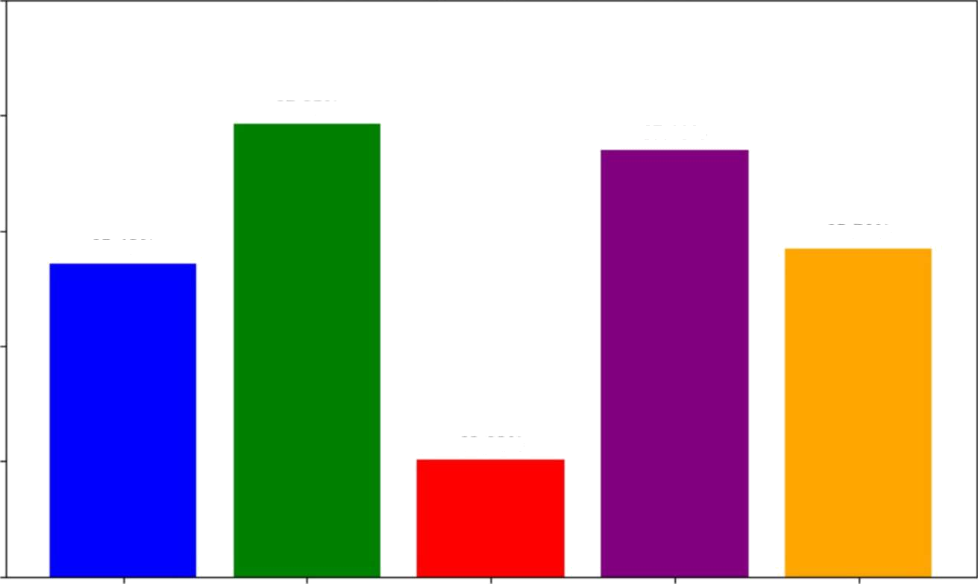
100
Model Accuracy Comparison (90-100%)
98
97.85%
97.40%
Accuracy (36)
9b
95.43°A
9570%
92
9K02%
90
u
SVM
KNN
Models
Perceptron
Decision Tree

Slide 11
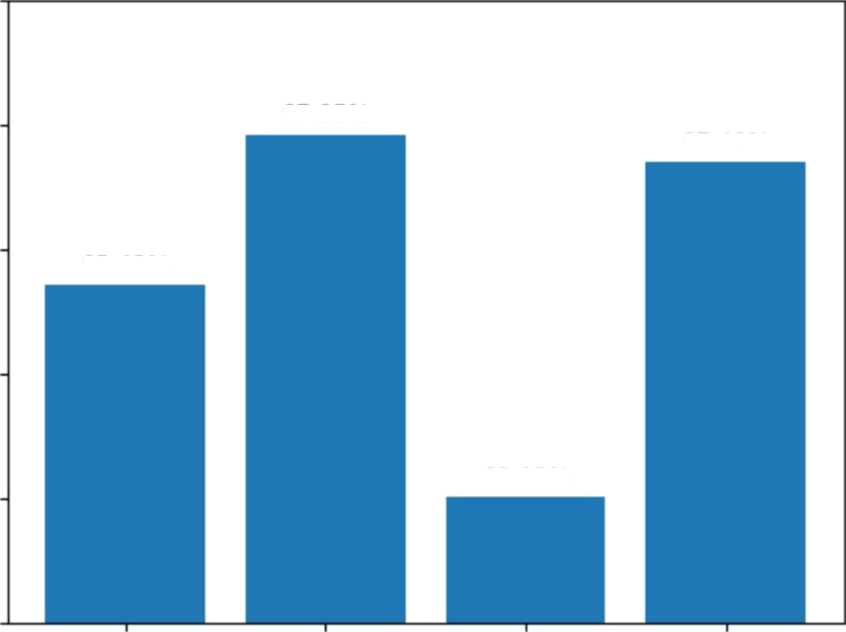

100
98
97.85%
97.40⁰/a
Accuracy ( •a)
96
95.43%
92.02%
92
90
SVM
MN
Perceptron

Slide 12







This project successfully demonstrdtes the use of
machine |  | learning |  | techniaues tO |  |  |  |  | automatically
c(dSSif y emdi(s as Spim or not spam. By applying
d¿Itči preprocessing and TF-IDF fedture extraction,
the text data was effectively converted into a
fo | rmdt |  | suitable |  | for | mo | del | tr¿iining.
https://github.com/2403A51186/EMAIL-SPAM- DETECTION-

